Slide 1
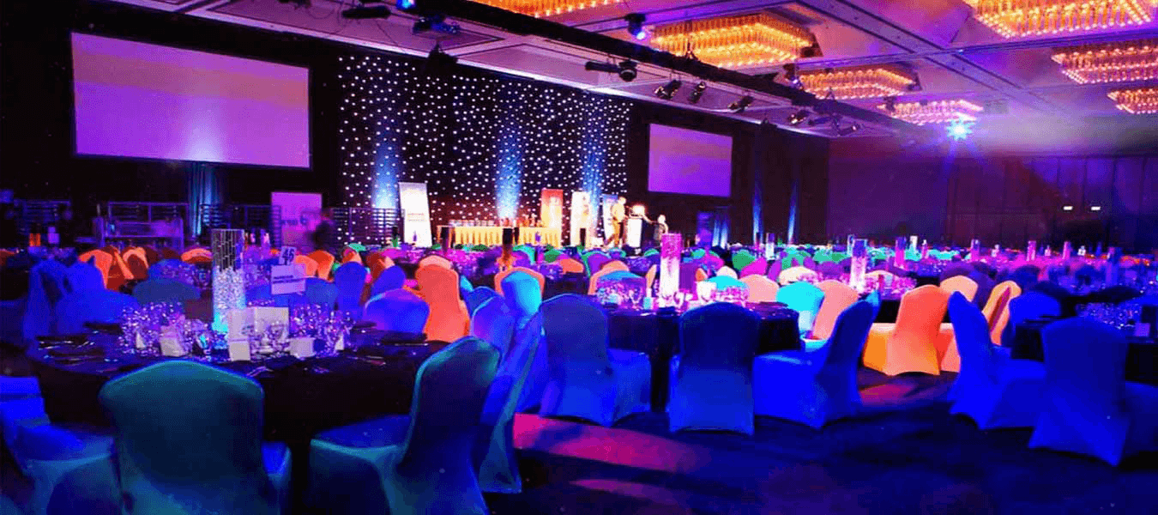


CHAITANYAINSTITUTEOFTECHNOLOGY &SCIENCE HANAMKONDA,WARANGAL -506001 DEPARTMENT OF COMPUTER SCIENCE ANDENGINEERING
EVENT MANAGEMENT SYSTEM
Presented by Guided by
R.VARUN GUPTHA(214931028L) Name:Mr. V.Srujan
G.BHARGAV(20493T0985)
B.VARUNDHAR(20493T0975)
M.CHANTI(20493T1018)

Slide 2

ABSTRACT
The Event Management System is a robust and user-friendly mini-project designed to facilitate efficient event planning and execution. This web-based application aims to streamline the process of organizing diverse events, ranging from conferences, workshops, seminars, to social gatherings and corporate functions. The system incorporates an intuitive interface, enabling event organizers to manage tasks, resources, and attendees seamlessly.The Event Management System is designed to enhance event planning efficiency, reduce manual effort, and enhance overall event experiences for organizers and attendees alike. By employing this mini-project, individuals and organizations can successfully execute memorable events, fostering better engagement and satisfaction among participants.

Slide 3
INTRODUCTION
Welcome to the world of Event Management System! Our mini project aims to provide an efficient and user-friendly platform for organizing, planning, and managing events of all kinds. Whether it's a corporate conference, a social gathering, a wedding, or any other event, our system is designed to streamline the entire event lifecycle.
In today's fast-paced world, managing events can be a daunting task, involving countless details, schedules, and communication with various stakeholders. The Event Management System is here to simplify this process, allowing event organizers to focus on creativity and engagement while leaving the administrative hassles to the software. It provides a seamless experience, making event management a breeze and allowing you to focus on creating memorable moments for all involved.

Slide 4
FUNCTIONAL REQURIMENTS
1.Gather event details such as event name, date, time, location, description, and type of event.
2.Provide organizers with insights to improve future events.
3.Implement an admin panel to manage events and perform necessary system configurations.
4.User can see the previous done events by our team.

Slide 5
NON FUNCTIONAL REQUIRMENTS
1.User must not negotiate with the charge of an Event.
2.The system is compatible with various browsers, devices, and operating systems to cater to a diverse user base.
3.The system is scalable to accommodate increasing user and event data without requiring major architectural changes

Slide 6
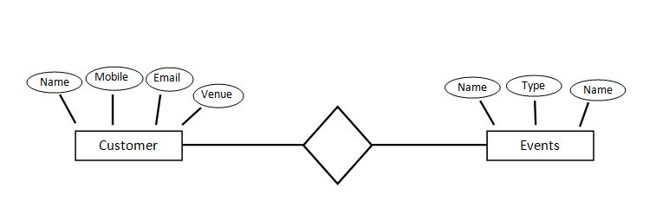
ER-DIAGRAM

Slide 7
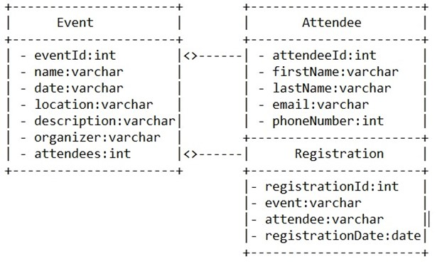
CLASS DIAGRAM:

Slide 8
SOFTWARE REQURIMENTS:
Web Technologies : HTML, CSS, Bootstrap
Scrippting Language : Javascript
Data Base: My sql
Operating System : Windows
HARDWARE REQUIREMENTS:
RAM:2GB
PROCESSER:Dual core
HARD DISK:510GB

Slide 9
ADVANTAGES:
Automation features of an EMS help save time by automating repetitive tasks such as sending invitations, reminders, and registration confirmations.
EMS platforms can accommodate events of different sizes and complexities, from small workshops to large-scale conferences or exhibitions.
DISADVANTAGES:
Small businesses or organizations with limited budgets might find it challenging to afford a high-quality system.
Integrating an event management system with other software applications used by your organization can be a challenge.

Slide 10
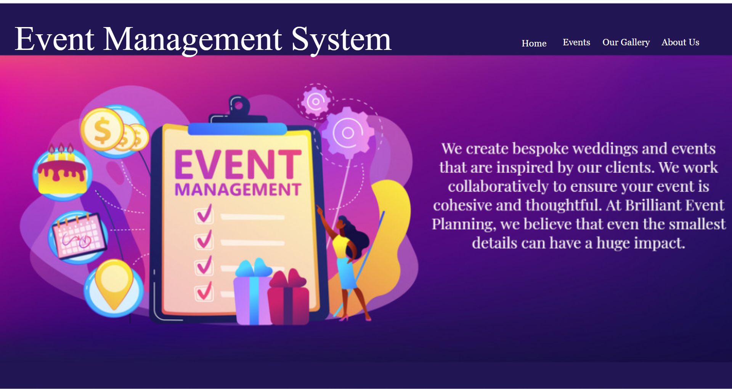
OUTPUT:

Slide 11
CONCLUSION
It has been a great pleasure for me to work on this exciting and challenging project. The event management system has proven to be an invaluable tool in streamlining and enhancing the planning, organization, and execution of events. The event management system has revolutionized the way events are planned and executed. Its impact on efficiency, user experience, data utilization, communication, security, and cost-effectiveness makes it an indispensable tool for event professionals. With continuous improvements and updates, the system is poised to further enhance the event management landscape and create memorable experiences for attendees worldwide. This will provide better opportunities and guidance in future in developing projects independently.

Slide 12


